Slide 1




motion detection
By Aysegul Kayikci (001138854), Asli Kanturk (001191449), Arda Sahan (001150659) and Ozan Gokberk (001151346)

Slide 2
Why this topic?
Motion detection is a very common system used worldwide. Motion detectors are designed to measure movement/motion caused by people or objects.
These systems are used in many situations such as surveillance cameras in homes and businesses, tissue/soap dispensers, doorbells, automatic doors and even cars.
Therefore, this topic was chosen due to how present it is in the modern world of technology. As a group we also found this topic to be very interesting as it is something we encounter on a day-to-day basis.

Slide 3
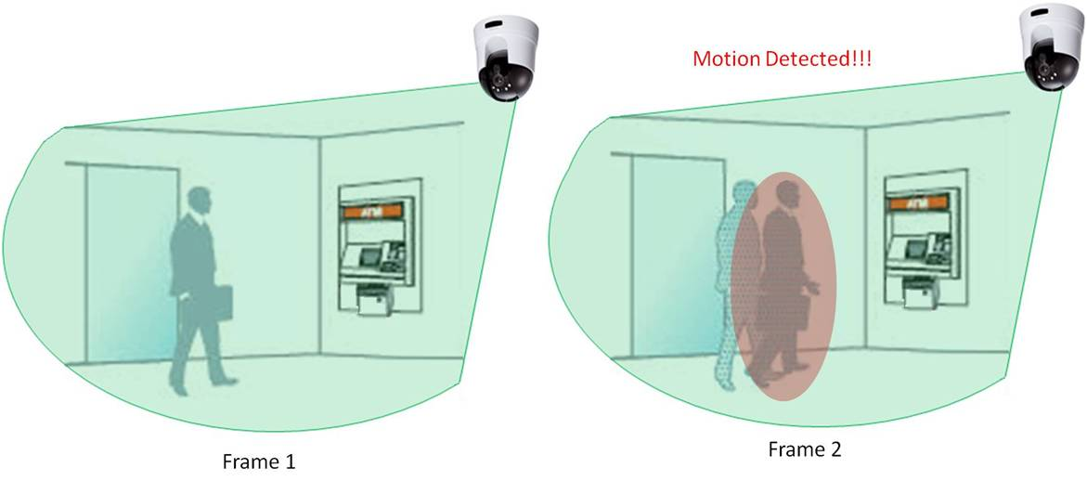
What is the problem?
Surveillance systems are found everywhere from homes to business to schools. Therefore, our team chose this topic since surveillance systems use motion detection to identify any moving objects in an environment.
Our objective here is to find different solutions to solve this problem above.

Slide 4
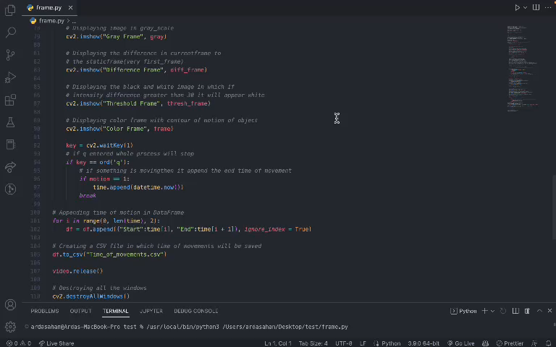

Frame difference Approach (arda)
Frame difference is a common method that is used for motion detection.
This method identifies the presence of moving objects by comparing the difference between two adjacent frames.
The initial frame (can also be called the background frame) should be static meaning there should not be any movements. The difference between the initial and current frame is found then a threshold is applied which helps determine if motion has taken place. Therefore, this comparison highlights the areas which have changed in the current frame from the initial frame. (Rath, 2021)

Slide 5
Advantages & disadvantages of frame difference
Advantages:
This method requires low computation power. As it does not use any neural network or deep learning technique therefore, it is not computationally demanding.
Works well with static cameras when the initial background does not change for example, an empty road.
Disadvantages:
Does not work well with moving cameras since the current frame will constantly be changing and the system will not be able to compare it to the initial frame and will just show motion everywhere.
Requires good lighting as it may detect a single object as two separate objects.
Multiple objects that are close to each other may be recognized as one.

Slide 6

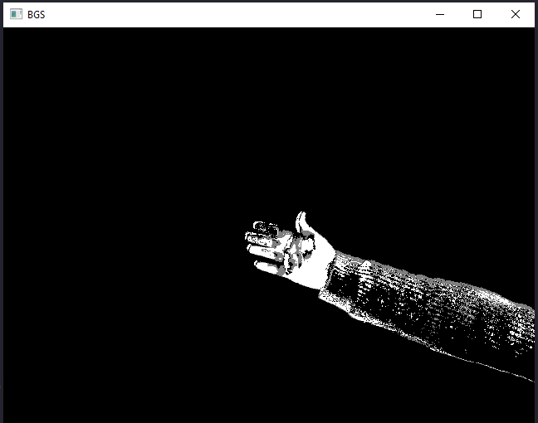
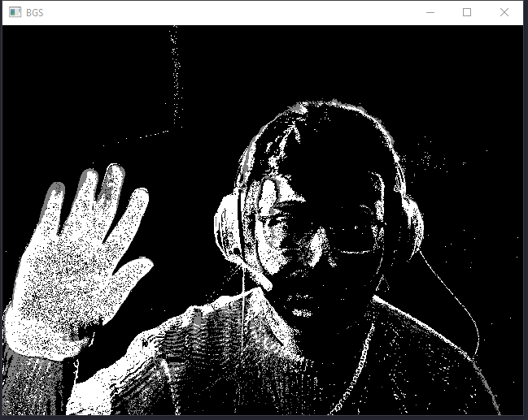
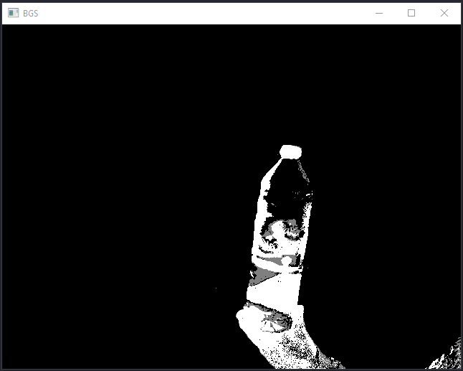
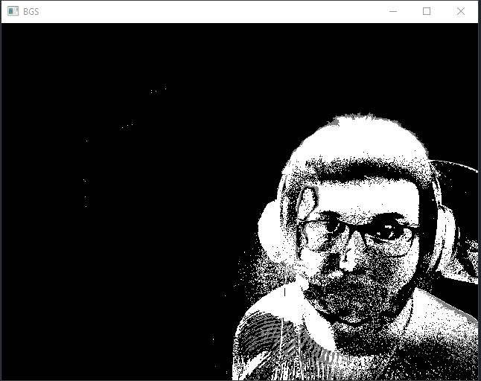
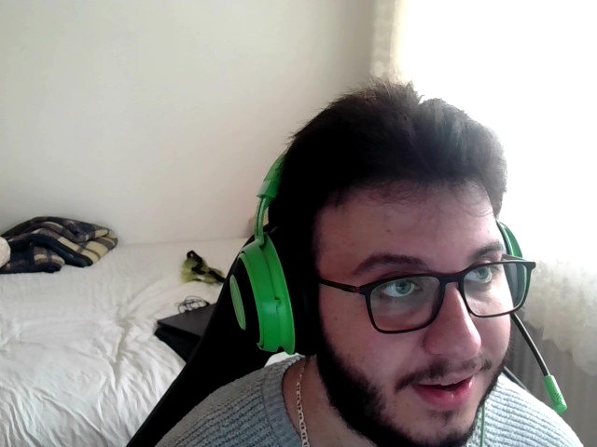
Background Subtraction Approach (ozan)
Background subtraction is the most popular method for motion detection.
BGS/BSM works by comparing moving parts of a video to a background and a foreground image.
BGS/BSM finds foreground objects by isolating them and then comparing the foreground object to the initial frame where there are no foreground objects present. This will create a difference between them and create a distance matrix. This simply compares the difference between two frames, one without any objects and one with objects with the threshold value. Threshold value is measured by taking the first few frames of the video. Therefore, if the difference of the two frames is larger than the threshold value, this will result as an object moved. (Verma & Kumar, 2022)

Slide 7
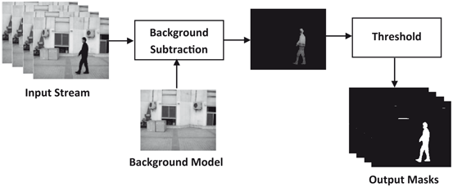
Advantages & disadvantages of Background subtraction
Advantages:
Different threshold selected for each pixel.
The threshold pixels are adapting by time.
Objects can become apart of the background whilst not destroying or altering the existing background model.
Provides relatively fast recovery.
Disadvantages:
Not able to deal with sudden drastic lighting changes.
Gaussians method is important to initialize.
There are a lot of parameters, and these parameters should be selected carefully.

Slide 8
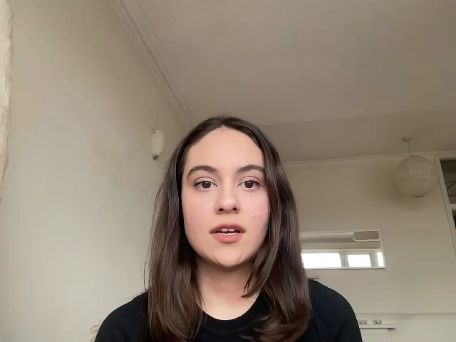
Optical flow BASED MOTION DETECTION (asli)
Optical Flow
Optical flow is a task of per-pixel motion estimation between two consecutive frames in one video. In other words, the Optical Flow task implies the calculation of the shift vector for pixel as an object displacement difference between two neighbouring images (Huang et al, 2019; Pathak et al, 2018).
Optical Flow Applications
Optical Flow’s main purpose is to forecast the object’s displacement vector caused by its camera movements or motion. Mostly, Optical Flow is found in video editors such as compression, slow-motion and stabilization (Pathak et al, 2018). Furthermore, Action Recognition tasks and real-time tracking systems are commonly used methods for Optical Flow (Snah et al, 2021; Huang et al, 2019).
Optical Flow Methods
It is identified that there are two types of Optical Flow: Sparse Optical Flow and Dense Optical Flow. Using a Sparse Optical Flow means not having the motion information about pixels that are not contained in it. This restriction can be lifted using Dense Optical Flow algorithms which are supposed to calculate a motion vector for every pixel in the image (Huang et al, 2019; Pathak et al, 2018). That is why, the Dense Optical flow is the chosen method for this algorithm.

Slide 9
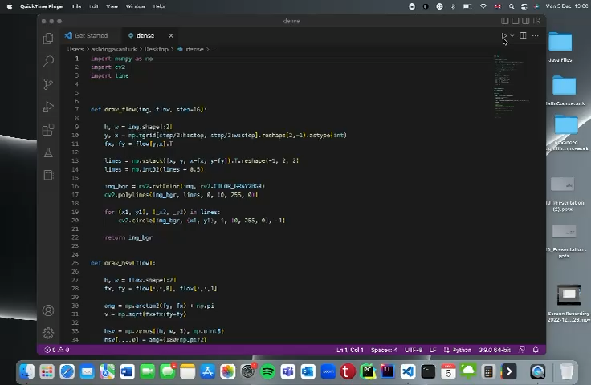
Optical flow Approach(asli)
Implementing Dense Optical Flow
Dense optical flow attempts to calculate the optical flow vector for every pixel in each frame. Also, to receive a more accurate and a denser outcome for applications such as a learning structure from motion and video segmentation, Dense Optical Flow implementations are described as an effective technique to estimate the relative movement between the object and camera (Huang et al, 2019; Pathak et al, 2018).
Advantages and Disadvantages of Dense Optical Flow
According to Snah and Xuezhi (2021), dense optical flow estimation is a costly algorithm as it calculates each pixel. On the other hand, it is a commonly used method because of its higher accuracy in areas such as motion learning and video segmentation (Huang et al, 2019).

Slide 10
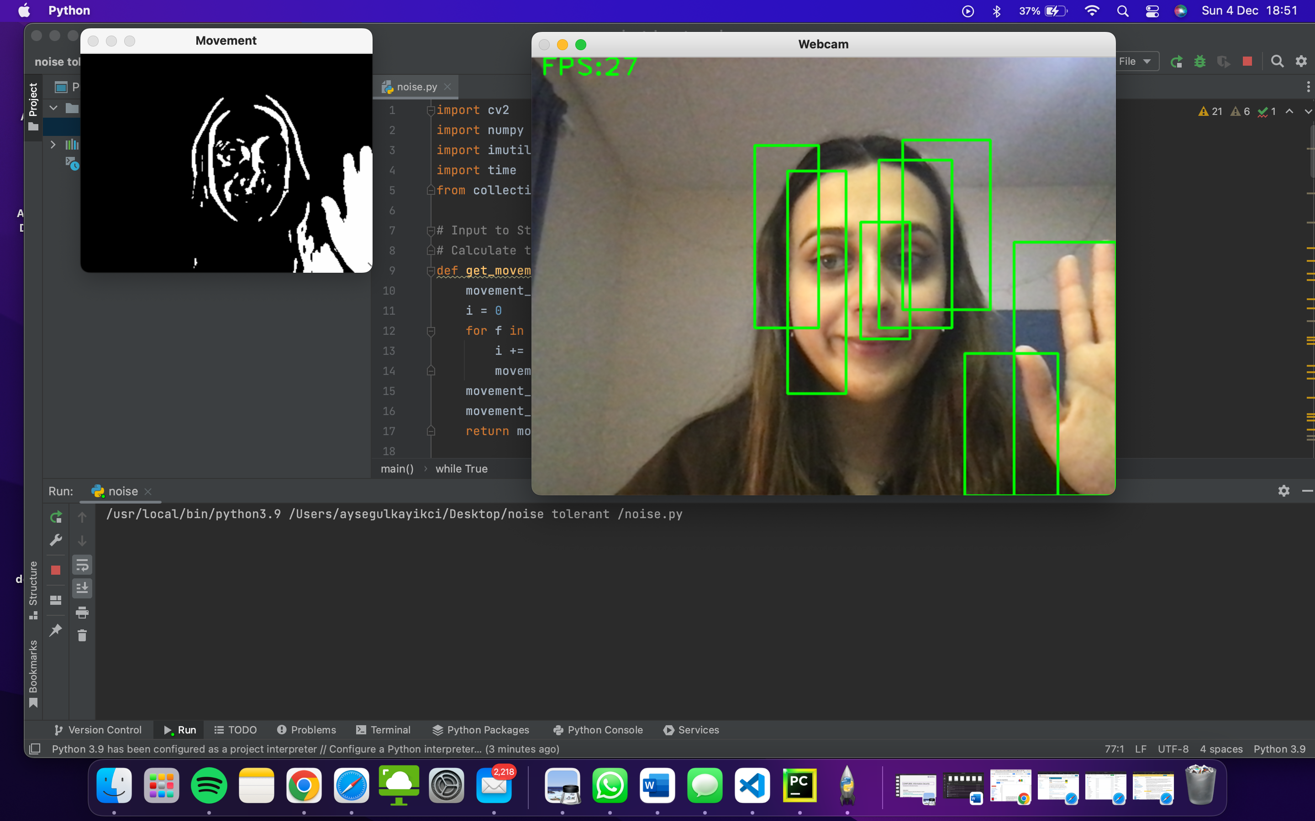
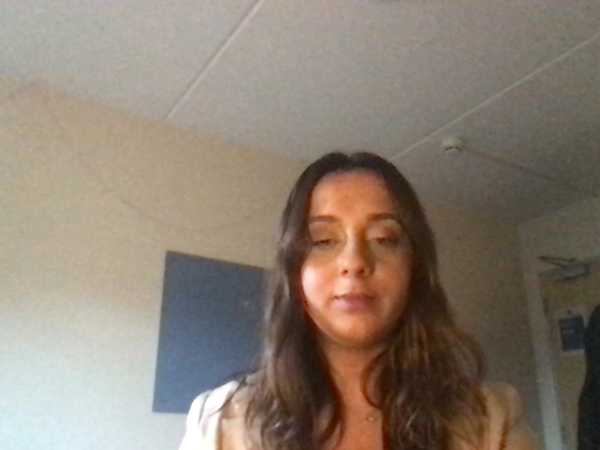
Noise-Tolerant approach (aysegul)
Motion detection is often met in video
analytics projects.
Python-based Motion Detector
The approach was to compare the last two frames and take the difference between them. While it works it is not very robust to simple noise and will create a lot of false positives.
Noise is a natural or technical phenomenon observed in a video stream that should be ignored, otherwise it causes false positive detections. Noise examples:
glare of sunlight;
reflection of objects from transparent glass surfaces;
vibrations of small objects in the frame;
etc.

Slide 11
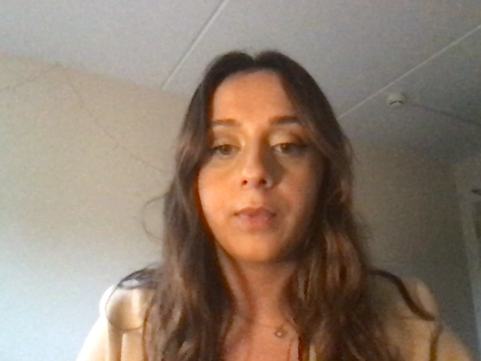
Advantages & Disadvantages
Advantages:
It also provides security against sound
Saving energy, for example, working with censored devices
Disadvantages:
This algorithm, which works with voice and movement, causes energy wastage according to the area of use (eg: sensor devices installed for security purposes, detecting movements other than movements that are specifically required to detect, and activating the device)

Slide 12
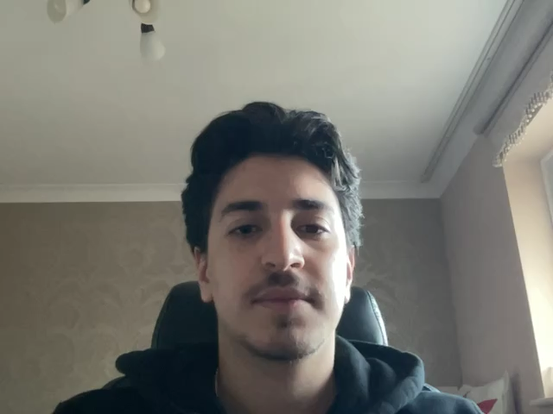
conclusion
Summary of The Presentation
In conclusion, we have found and researched four different algorithms/ methods of solving our problem which was surveillance systems that use motion detection to identify any moving objects in an environment. The four algorithms found and discussed were Frame Difference, Background Subtraction, Optical Flow and Noise-Tolerant. Using these solutions, we have managed to solve our problem by creating a surveillance system which creates a safer environment for people that have concerns about their safety.
Advantages & Disadvantages of These Algorithms
Frame Difference: As an advantage of this method, it works well for static cameras however, it struggles and does not work with moving cameras.
Background Subtraction: This method provides relatively fast recovery yet not able to deal with sudden drastic lighting changes.
Optical Flow: Dense optical flow is a costly algorithm on the other hand, it is a commonly used method because of its higher accuracy.
Noise-Tolerant: It provides security against sound but causes energy wastage detecting movements other than movements that are specifically required to detect.

Slide 13
references
References
Algorithms for learning F urnkranz - ofai.at (no date). Available at: https://ofai.at/papers/oefai-tr-96-07.pdf (Accessed: December 5, 2022).
Bwsw (2/12/22) BWSW/RT-motion-detection-opencv-python: High-performance noise-tolerant motion detection algorithm implemented with Python3, Numba, Numpy, GitHub. Available at: https://github.com/bwsw/rt-motion-detection-opencv-python (Accessed: December 5, 2022).
Goldman, S.A. and Scott, S.D. (no date) A theoretical and empirical study of a noise-tolerant algorithm to learn geometric patterns - machine learning, SpringerLink. Kluwer Academic Publishers. Available at: https://link.springer.com/article/10.1023/A:1007681724516 (Accessed: December 2, 2022).
Huang, J. et al. (2019) “An efficient optical flow-based motion detection method for non-stationary scenes,” 2019 Chinese Control And Decision Conference (CCDC) [Preprint]. Available at: https://doi.org/10.1109/ccdc.2019.8833206.
Pathak, S. et al. (2018) “Distortion-robust spherical camera motion estimation via dense optical flow,” 2018 25th IEEE International Conference on Image Processing (ICIP) [Preprint]. Available at: https://doi.org/10.1109/icip.2018.8451406.
Rath, S.R. (2021) Moving object detection, DebuggerCafe. Available at: https://debuggercafe.com/moving-object-detection-using-frame-differencing-with-opencv/ (Accessed: December 5, 2022).
Shah, S. T. and Xuezhi, X. (2021) “Traditional and modern strategies for optical flow: An investigation,” SN Applied Sciences, 3(3). Available at: https://doi.org/10.1007/s42452-021-04227-x.
Verma, S. and Kumar, A. (2022) Background subtraction, Background Subtraction - an overview | ScienceDirect Topics. Autonomous and Connected Heavy Vehicle Technology. Available at: https://www.sciencedirect.com/topics/engineering/background-subtraction#:~:text=The%20background%20subtraction%20method%20(BSM,background%20image%20and%20foreground%20image. (Accessed: December 5, 2022).

